Slide 1

CS231n 스터디
2022.05.10
발표자 : 유상준

Slide 2
목차
스터디 진행 상황
6~8강 스터디 내용 공유

Slide 3
참고자료 : https://www.youtube.com/watch?v=wEoyxE0GP2M&t=691s
https://bookandmed.tistory.com/56?category=1155428
https://m.blog.naver.com/wpxkxmfpdls/221852520447
https://docs.sangyunlee.com/deep-learning/cs231n-1/cs231n-lecture7-13

Slide 4
1. 스터디 진행 상황
매주 금요일. 12:30 릿잇에서.. or zoom
4회차 : 2022. 4. 1 – 6,7강 스터디
5회차 : 2022. 4. 29 – 8강 스터디
Lecture 6 : Training Neural Networks I
Lecture 7 : Training Neural Networks II
Lecture 8 : Deep Learning Software

Slide 5
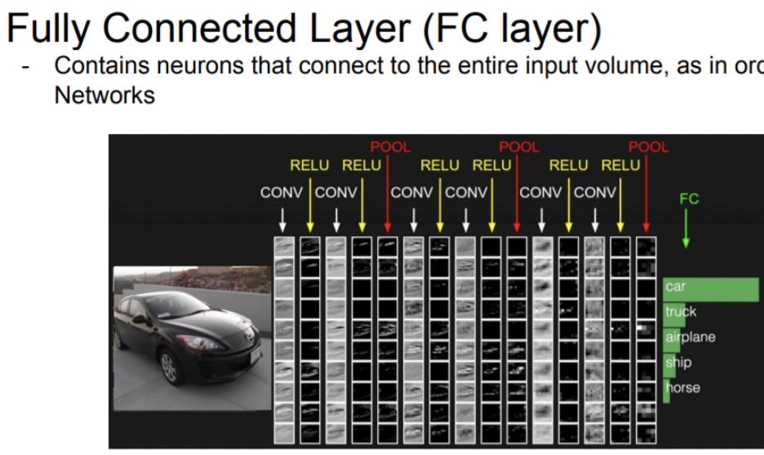
What we learned about CNN..
Lec 3 - FC
Lec 5 – CONV, POOL
In Lec 6 – RELU!

Slide 6
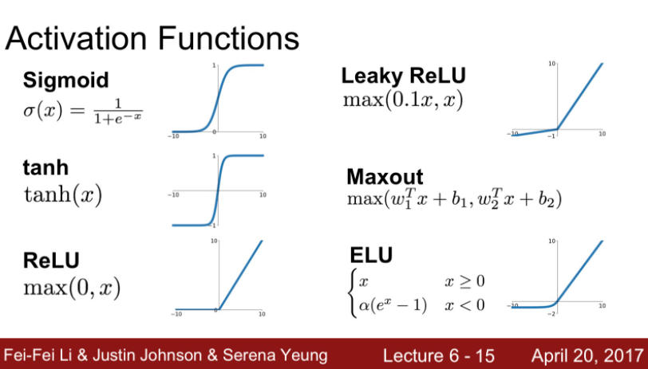
Activation Functions
Saturated (vanishing Gradient)
Zero – centered
Cost – parameter, exp()
Result : Using ReLU, Maxout, ELU

Slide 7
- Learning Process
Data preprocessing – In CV, Zero – Centered matter!
Choose the architecture
Check loss is reasonable – In no regularization, Loss ~2.3 (babysitting)
training
training with regularization and learning rate – Consider Hyperparameter + Lec 7

Slide 8
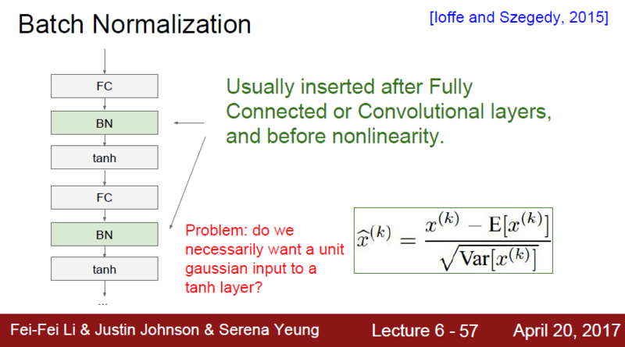
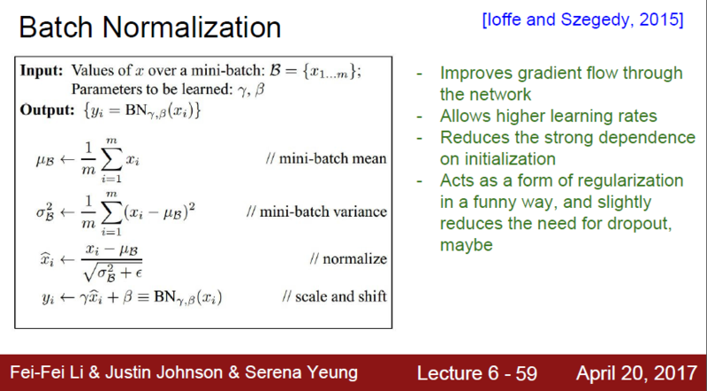
Make Gaussian distribution => Ctrl saturation
Consider Convolution’s character

Slide 9
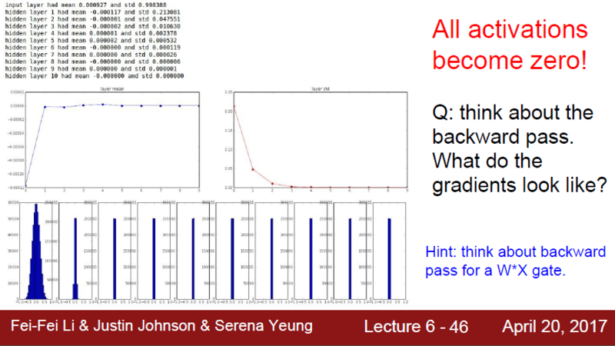
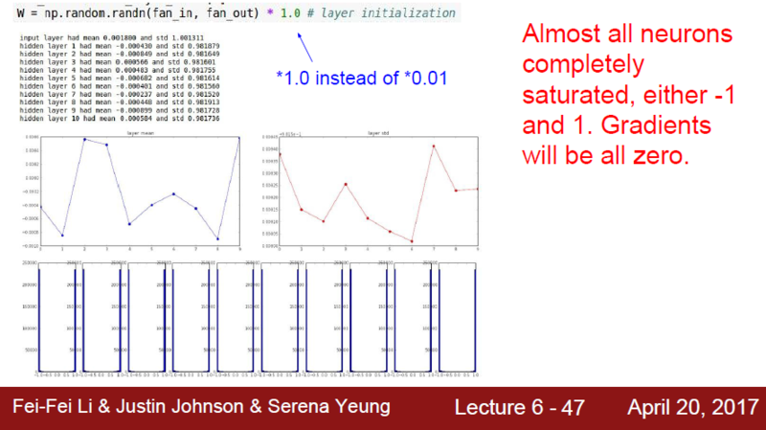
How to determine Weight?
1st. W= 0.01 * np.random.rand(D,H)
Not too big, not too small weight.
Various ways – Xavier initialization..

Slide 10
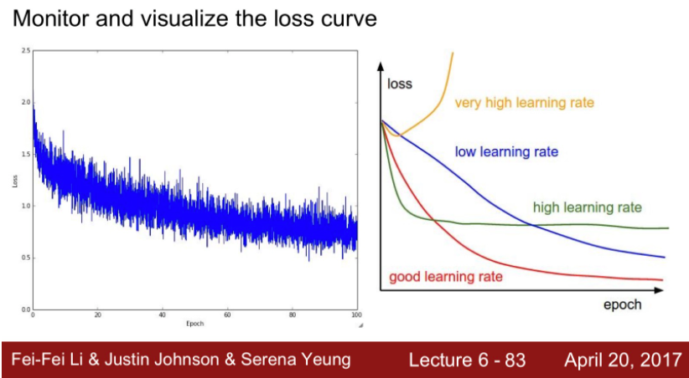
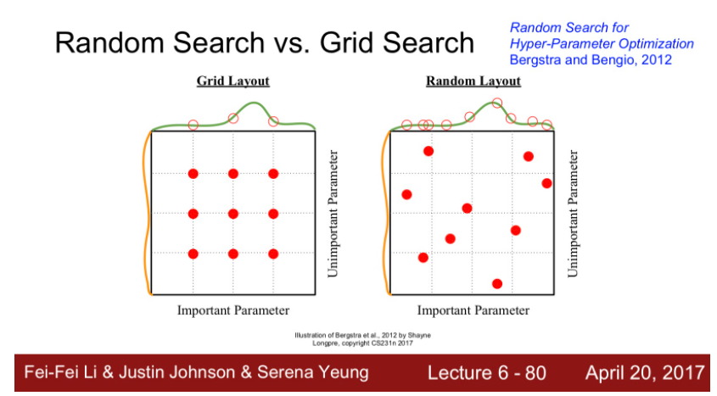
Hyperparameter Optimization
Cross validation
Random Search vs Grid Search

Slide 11
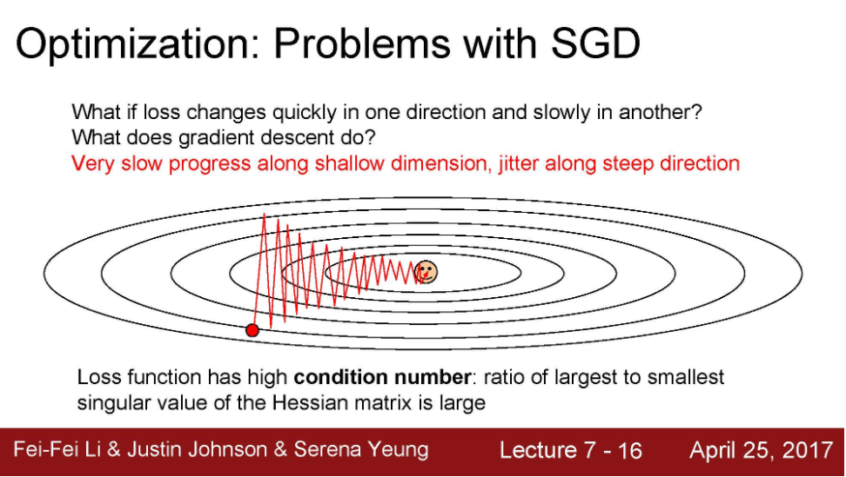
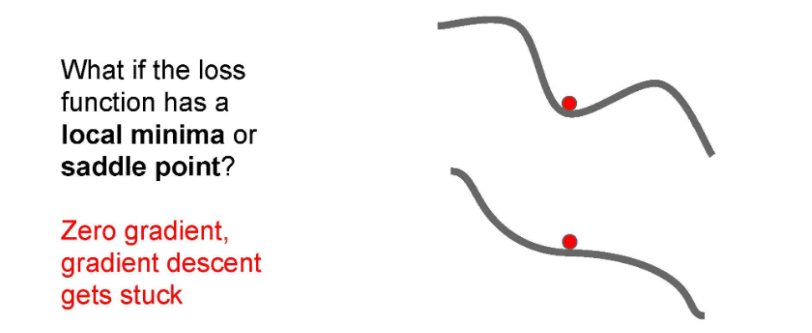
Problem & Solution in SGD
1. Using Momentum
ex) SGD + momentum,
Nesterov
2. Adaptive learning
ex) AdaGrad, RMSProp
Using both!: Adam!

Slide 12
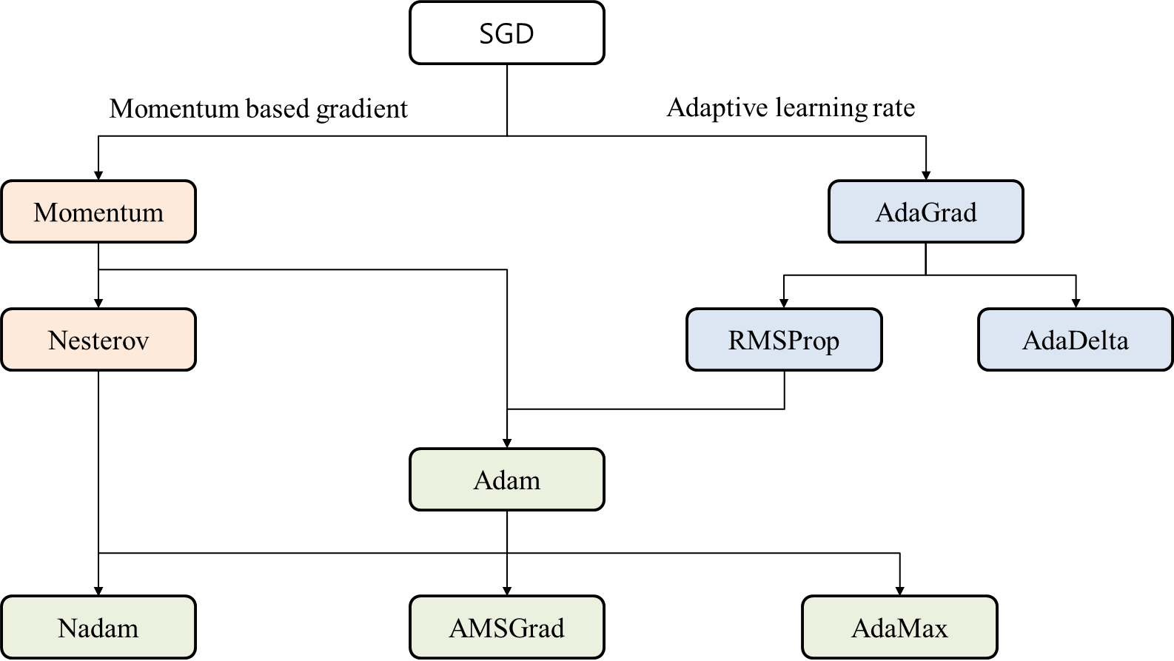

Slide 13
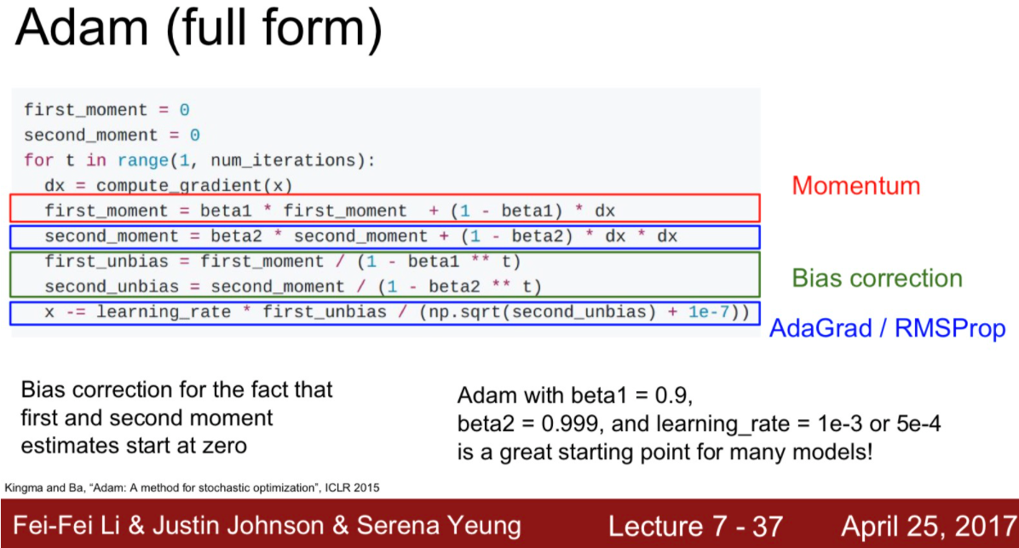
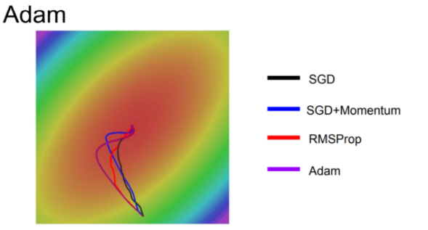

Slide 14
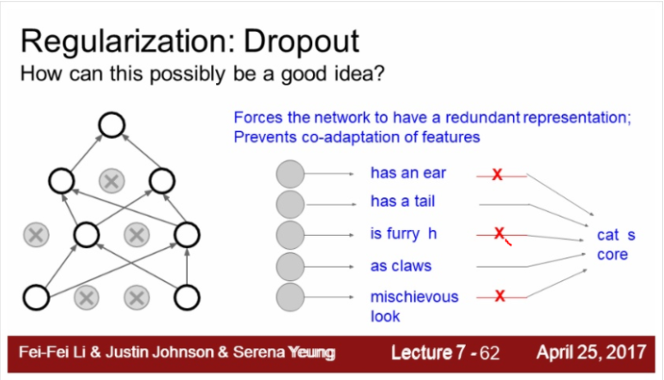
Beyond Training Error, solving overfit problem
Model Ensembles => 2%...
2. Regularization : Dropout

Slide 15
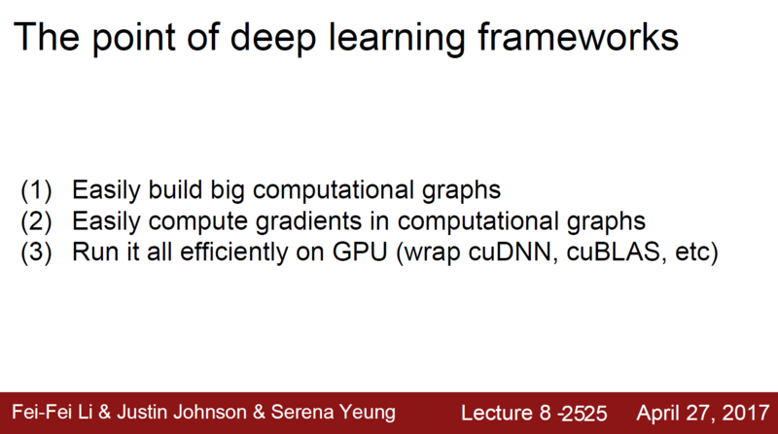

Slide 16
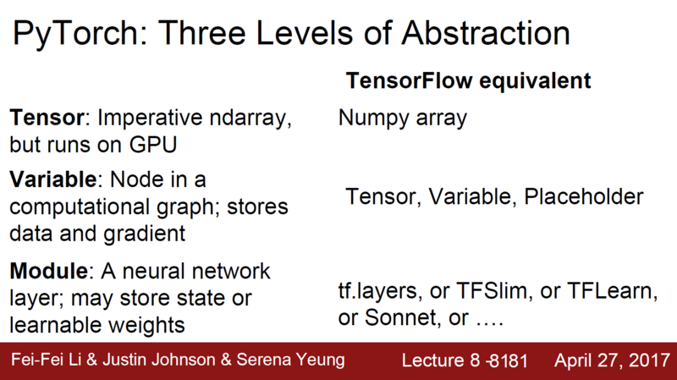

Slide 17
